Slide 1
OmniSC Server Inc.
TECHNICAL Writers review Meeting Fiscal 2023 Q2
Stephen P. Brown

Slide 2
Introduction
Welcome to the OmniSC Systems Inc. review meeting for Fiscal Year 2023 (FY2023), Quarter 2.
In our last meeting we discussed the new RESTful or Representational State Transfer (REST) Application Programming Interface (API) being created by our development (dev) team.
The project is internally referred to as “Scenario6” as our current Technical Writing team consists of six members.
OmniSC is growing as a corporation and we have allocated adequate resources to move this project forward.

Slide 3
Project Scenario 6 Review
Highlights:
OmniSC Acquiring Network Switch Vendor QuadConnect Inc. (FY2023 Q3)
Create a REST API between OmniSC server software and QuadConnect switch software.
REST commands will communicate between the devices to verify and collect code version reporting and licensing information.
API was deemed the perfect use-case for intra-device software communication.

Slide 4
API Specification Files
Developers will use API specification files for each coded API
Specification files define the specific component pieces of the API that will need to be coded.
What does that mean?
Think of these specification files as an application roadmap.
Each spec file is a guide of what needs to be created and it is used to keep track of the coding process and progress.
Hundreds of these files will need to be created, and maintained with content version source control.

Slide 5
OmniSC and QuadConnect Integration
OmniSC servers have multiple active license and firmware versions.
QuadConnect switches have multiple firmware versions.
The integration of the QuadConnect switches with OmniSC servers will require an API for each vendor’s device pairing:
Example:
QuadConnect Switch v12.0 ------REST3.0------ OmniSC v9.6(3)
QuadConnect Switch v11.3 -----REST2.1------ OmniSC v9.5(5)
QuadConnect Switch v11.2 -----REST2.2------ OmniSC v9.5(2)c
QuadConnect Switch v10.2 -----REST1.0------ OmniSC v8.0(1) (Legacy)
The tech writers must maintain hundreds of API documents and manuals, each unique to the switch firmware version and the server version.

Slide 6
Integration Future State
Massive amount of documents to maintain, update, and keep strict document version control.
The number of documents should decrease as we phase out older “legacy” versions of supported code from QuadConnect switches.
Opportunity for new client software contracts and new hardware sales. Our customer facing documentation must be consistent and showcase a single vision for the two merged companies.
Additional needs:
Onsite Engineers need online documentation that will automatically resize for phones, tablets and laptop PCs.

Slide 7
MadCap Flare with OmniSC
Analysis of both companies’ developer editing tools completed FY2022 Quarter 3.
MadCap Flare 2021r3 Identified as the best available tool for the integration.
OmniSC developers prefer creating APIs in basic text editors like Notepad ++, but use Swagger Open Source (OpenAPI) Editor to preview the output. Swagger gives error reporting and syntax error guidance.
Swagger allows exporting the text into HTML, HTML2 and Dynamic HTML.
All of these source API spec files can be imported directly into MadCap Flare and source linked for version control.

Slide 8
MadCap Flare with QuadConnect
Analysis showed the QuadConnect developers prefer creating APIs in HTML and Markdown.
QuadConnect also prints manuals for customers as part of their support contract.
Adobe FrameMaker is used for their legacy User and Installation guides.
MadCap Flare can import FrameMaker books, export pdf docs, as well as import HTML and Markdown source files.
Future state:
FrameMaker licenses will not be renewed.
Cost savings from FrameMaker contracts, re-routed to MC Flare.
All printed manuals will become web-based, online resources.

Slide 9
MadCap Flare Highlights
Imports a variety of file types needed for this merger allowing OmniSC flexibility for future and present needs:
Markdown, HTML, Text and DITA
FrameMaker (reduction of OmniSC monthly licensing costs)
Confluence (*reduction of OmniSC monthly licensing costs)
Microsoft Word and Excel
Allows multiple CSS styles for each web- portal implementation.
APIs can be imported, modified and added to the web portal.
Once the files are imported, MadCap Flare can build multiple format output files from Templates.
*If Confluence Wiki deemed obsolete by the new Web Portal

Slide 10
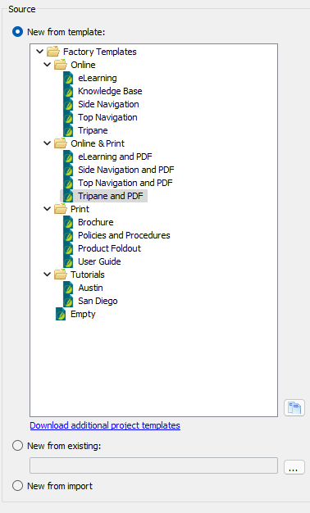
MC Flare Templates
Publishing to Multiple Outputs
eLearning with embedded chapter questions & review
Searchable KnowledgeBase
Content Re-Use
Flexible and User Friendly UI
Source to Content File Linking

Slide 11
Demo
Thank you for attending!
Demo
Swagger.io API Editing and File Export
https://editor.swagger.io/#

